Slide 1
Offset-free MPC for Plasma Processing
¹Kimberly J. Chan, ²Ging Martin, ²Kapil Sawlani, and ¹Ali Mesbah
¹Department of Chemical & Biomolecular Engineering, University of California, Berkeley
²Lam Research
2023 UNLOCK Project
Notes:
If you need to make any changes for a specific or personal presentation, go to View>Slide Master to edit anything that cannot be edited directly (e.g. the Seal and School, any slide layouts, etc.)

Slide 2
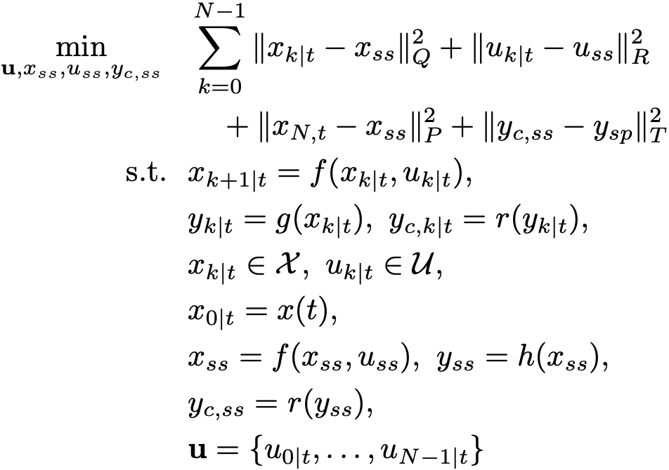
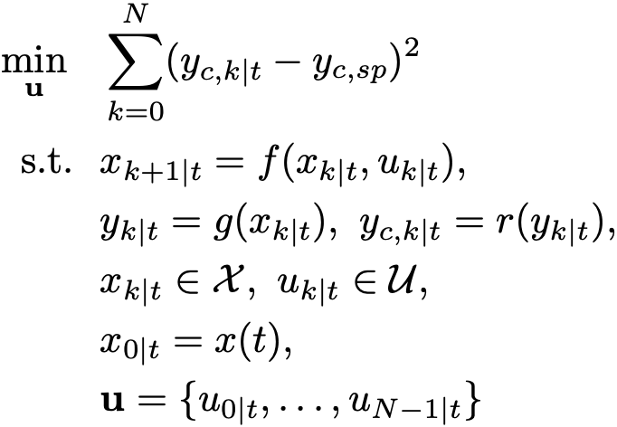
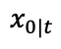
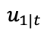
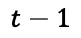
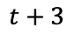
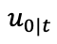
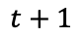
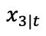
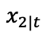
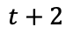
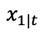
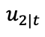
Model Predictive Control (MPC)
Past
Future (predictions)
Constraints
Offset-free MPC
$$x_{3|t}$$
$$x_{0|t}$$
States
$$x_{1|t}$$
Moving Window
$$x_{2|t}$$
$$u_{0|t}$$
$$u_{2|t}$$
Inputs
$$u_{1|t}$$
$$t−1$$
$$t$$
$$t+1$$
$$t+2$$
$$t+3$$
Time
Nominal MPC
Rawlings, Mayne, and Deihl, 2017.
Limon, et al., 2008.
Notes:
\min_{\mathbf{u}} ~~ & \sum_{k=0}^N (y_{c,k|t} - y_{c,sp})^2 \\
\text{s.t.} ~~ & x_{k+1|t} = f(x_{k|t},u_{k|t}), \\
& y_{k|t} = g(x_{k|t}), \\
& y_{c,k|t} = r(y_{k|t}), \\
& x_{k|t} \in \mathcal{X},~ u_{k|t} \in \mathcal{U}, \\
& x_{0|t} = x(t), \\
& \mathbf{u} = \{u_{0|t},\ldots,u_{N-1|t}\}
\min_{\mathbf{u}, x_{ss}, u_{ss}, y_{c,ss}} ~~ & \sum_{k=0}^{N-1} \|x_{k|t} - x_{ss}\|^2_Q + \|u_{k|t} - u_{ss}\|^2_R \\
& \quad+ \|x_{N,t} - x_{ss}\|^2_P + \|y_{c,ss} - y_{sp}\|^2_T\\
\text{s.t.} ~~ & x_{k+1|t} = f(x_{k|t},u_{k|t}), \\
& y_{k|t} = g(x_{k|t}), ~y_{c,k|t} = r(y_{k|t}), \\
& x_{k|t} \in \mathcal{X},~ u_{k|t} \in \mathcal{U}, \\
& x_{0|t} = x(t), \\
& x_{ss} = f(x_{ss}, u_{ss}), ~ y_{ss} = h(x_{ss}), \\
& y_{c,ss} = r(y_{ss}), \\
& \mathbf{u} = \{u_{0|t},\ldots,u_{N-1|t}\}

Slide 3
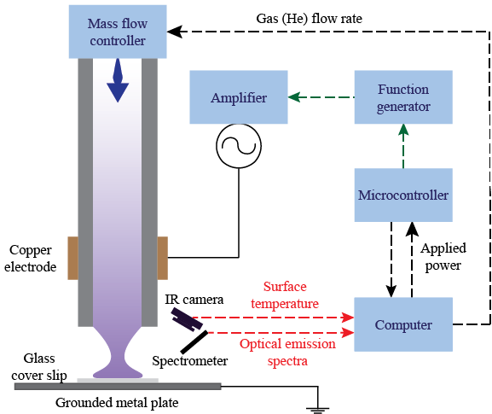
Atmospheric Pressure Plasma Jet (APPJ) Testbed

Slide 4
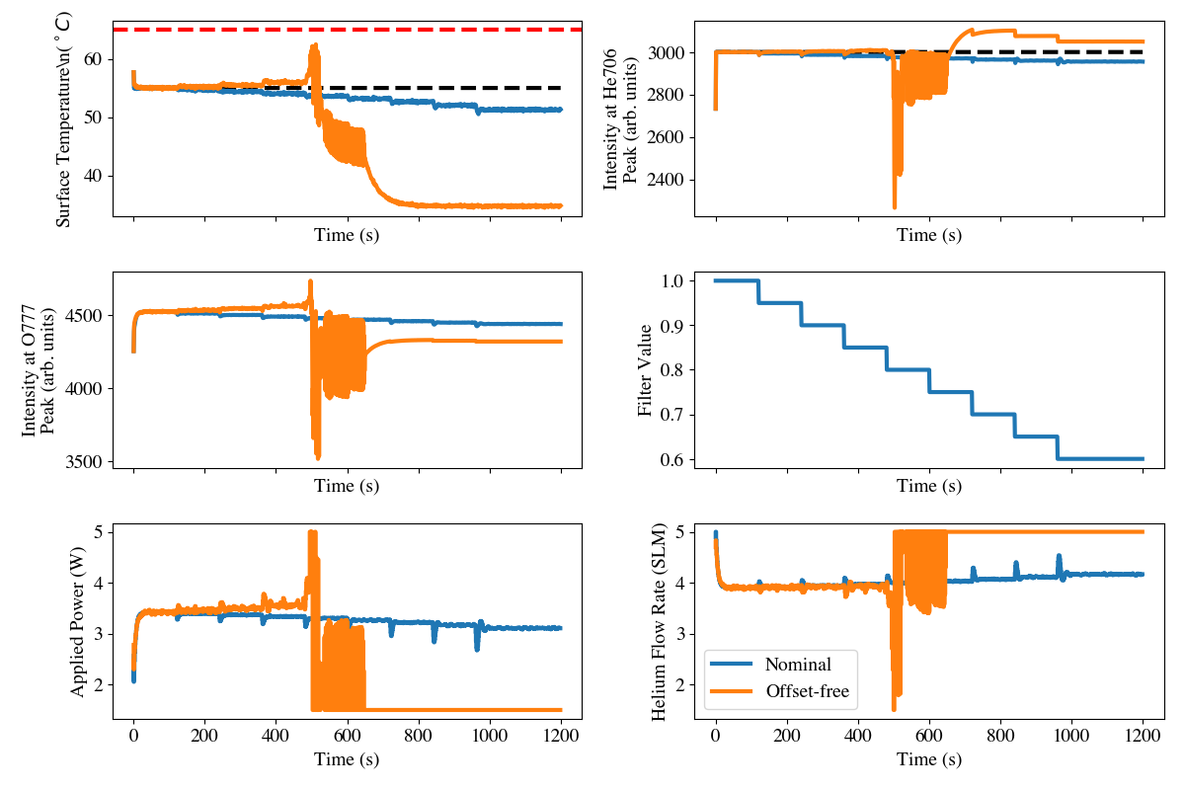
Closed-loop Simulations (Total Simulation Time: 20 min)

Slide 5
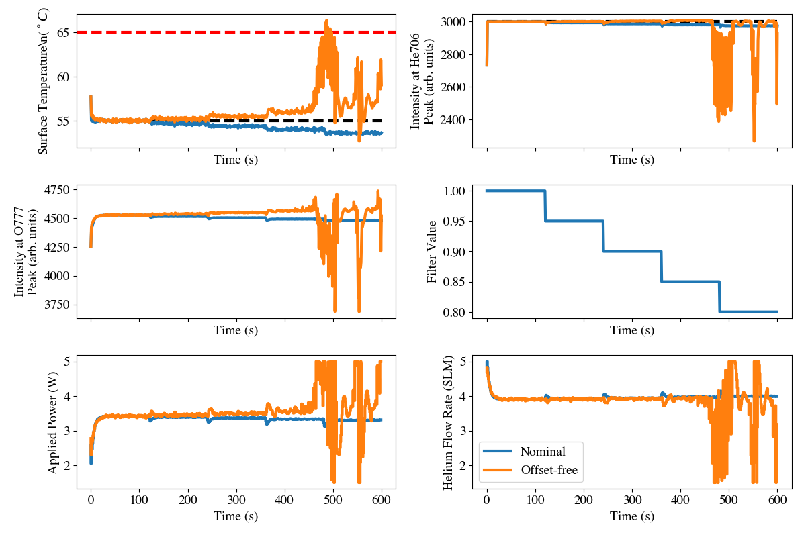
Closed-loop Simulations: Shorter Simulation (10 min)

Slide 6
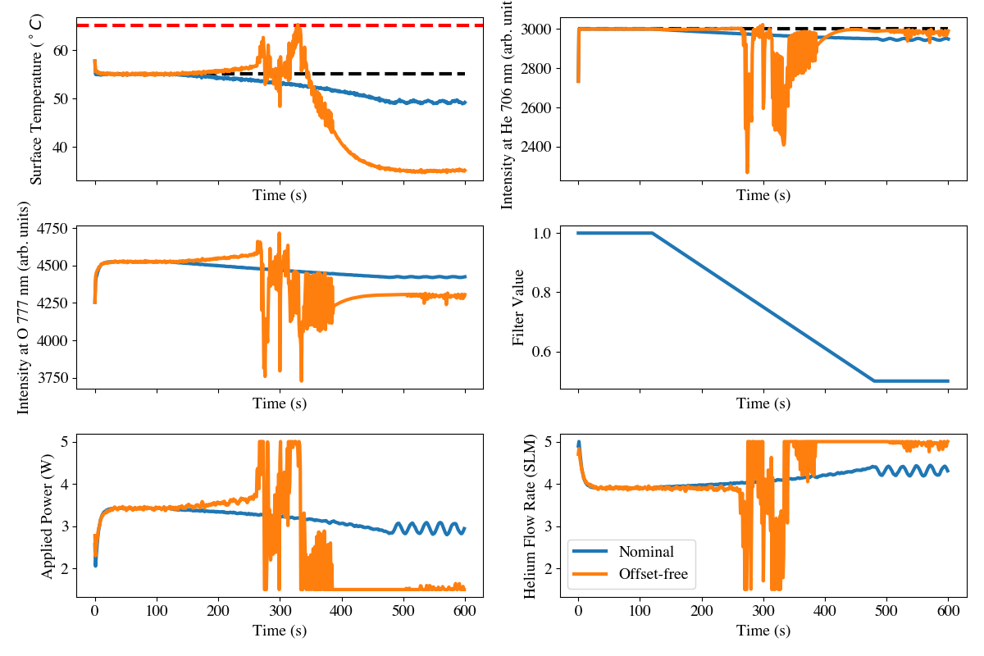
Closed-loop Simulations: Linearly-varying Filter Value

Slide 7
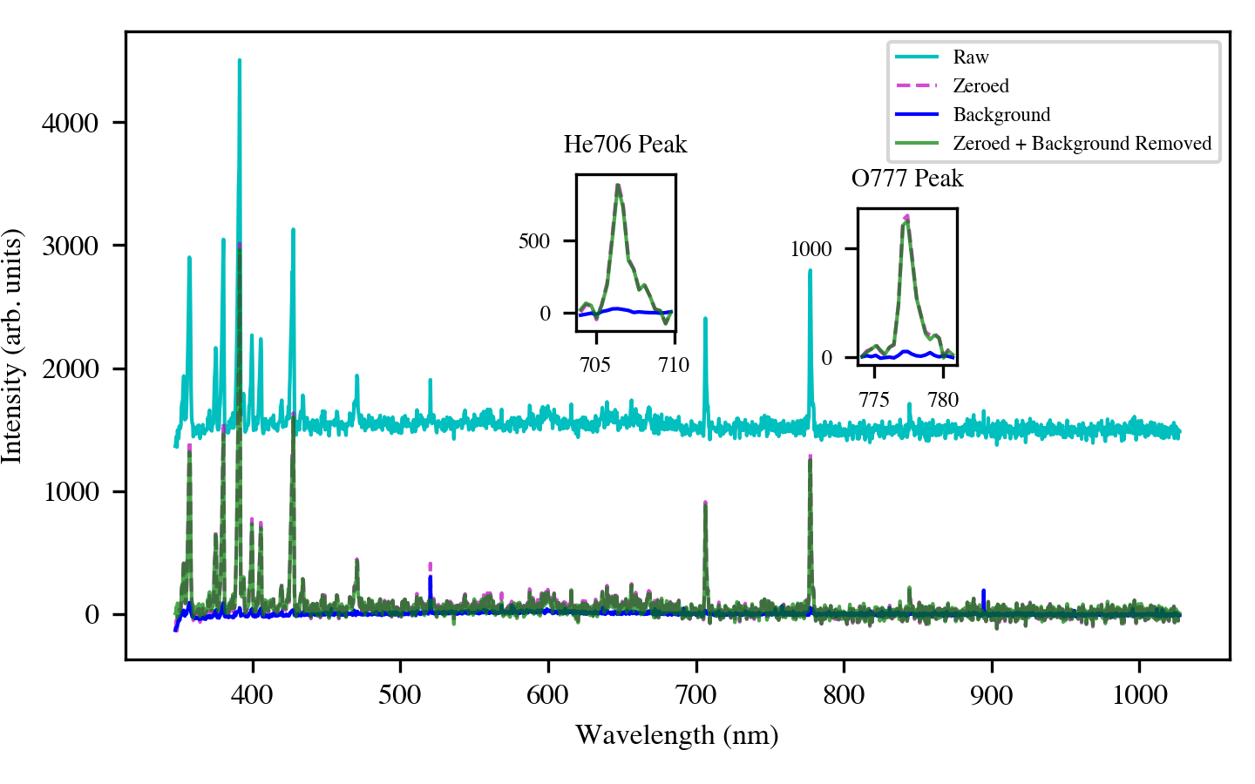
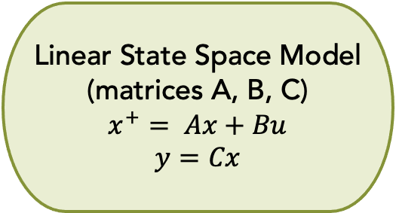
Data Engineering for Model Learning
OES
Subtract Mean Shift
Subtract Background
Measured Outputs
Scale to [1,1]
Processed Outputs
Surface Temperature
Inputs
Linear State Space Model (matrices A, B, C)
$$x^{+}= Ax+Bu$$
$$y=Cx$$
Learn Linear Model¹
Subtract nominal steady state
¹MathWorks (2023), n4sid function from MATLAB (R2021a) [MATLAB]. The MathWorks, Inc.

Slide 8
Large View of OES Processing

Slide 9
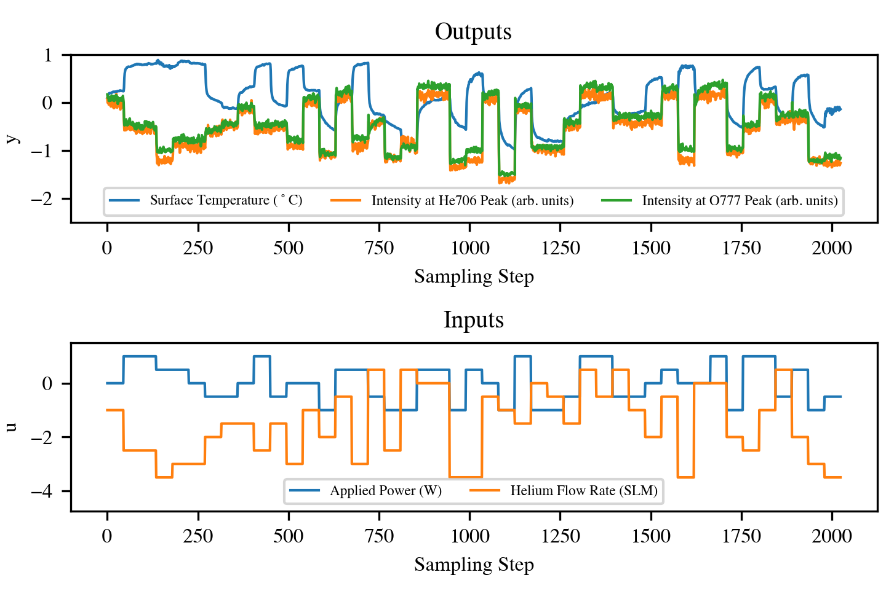
Open Loop Data
Processed outputs and inputs in deviation variables for fitting a data-driven model
Outputs → processed via Slide 5
Inputs and outputs → deviation variables

Slide 10
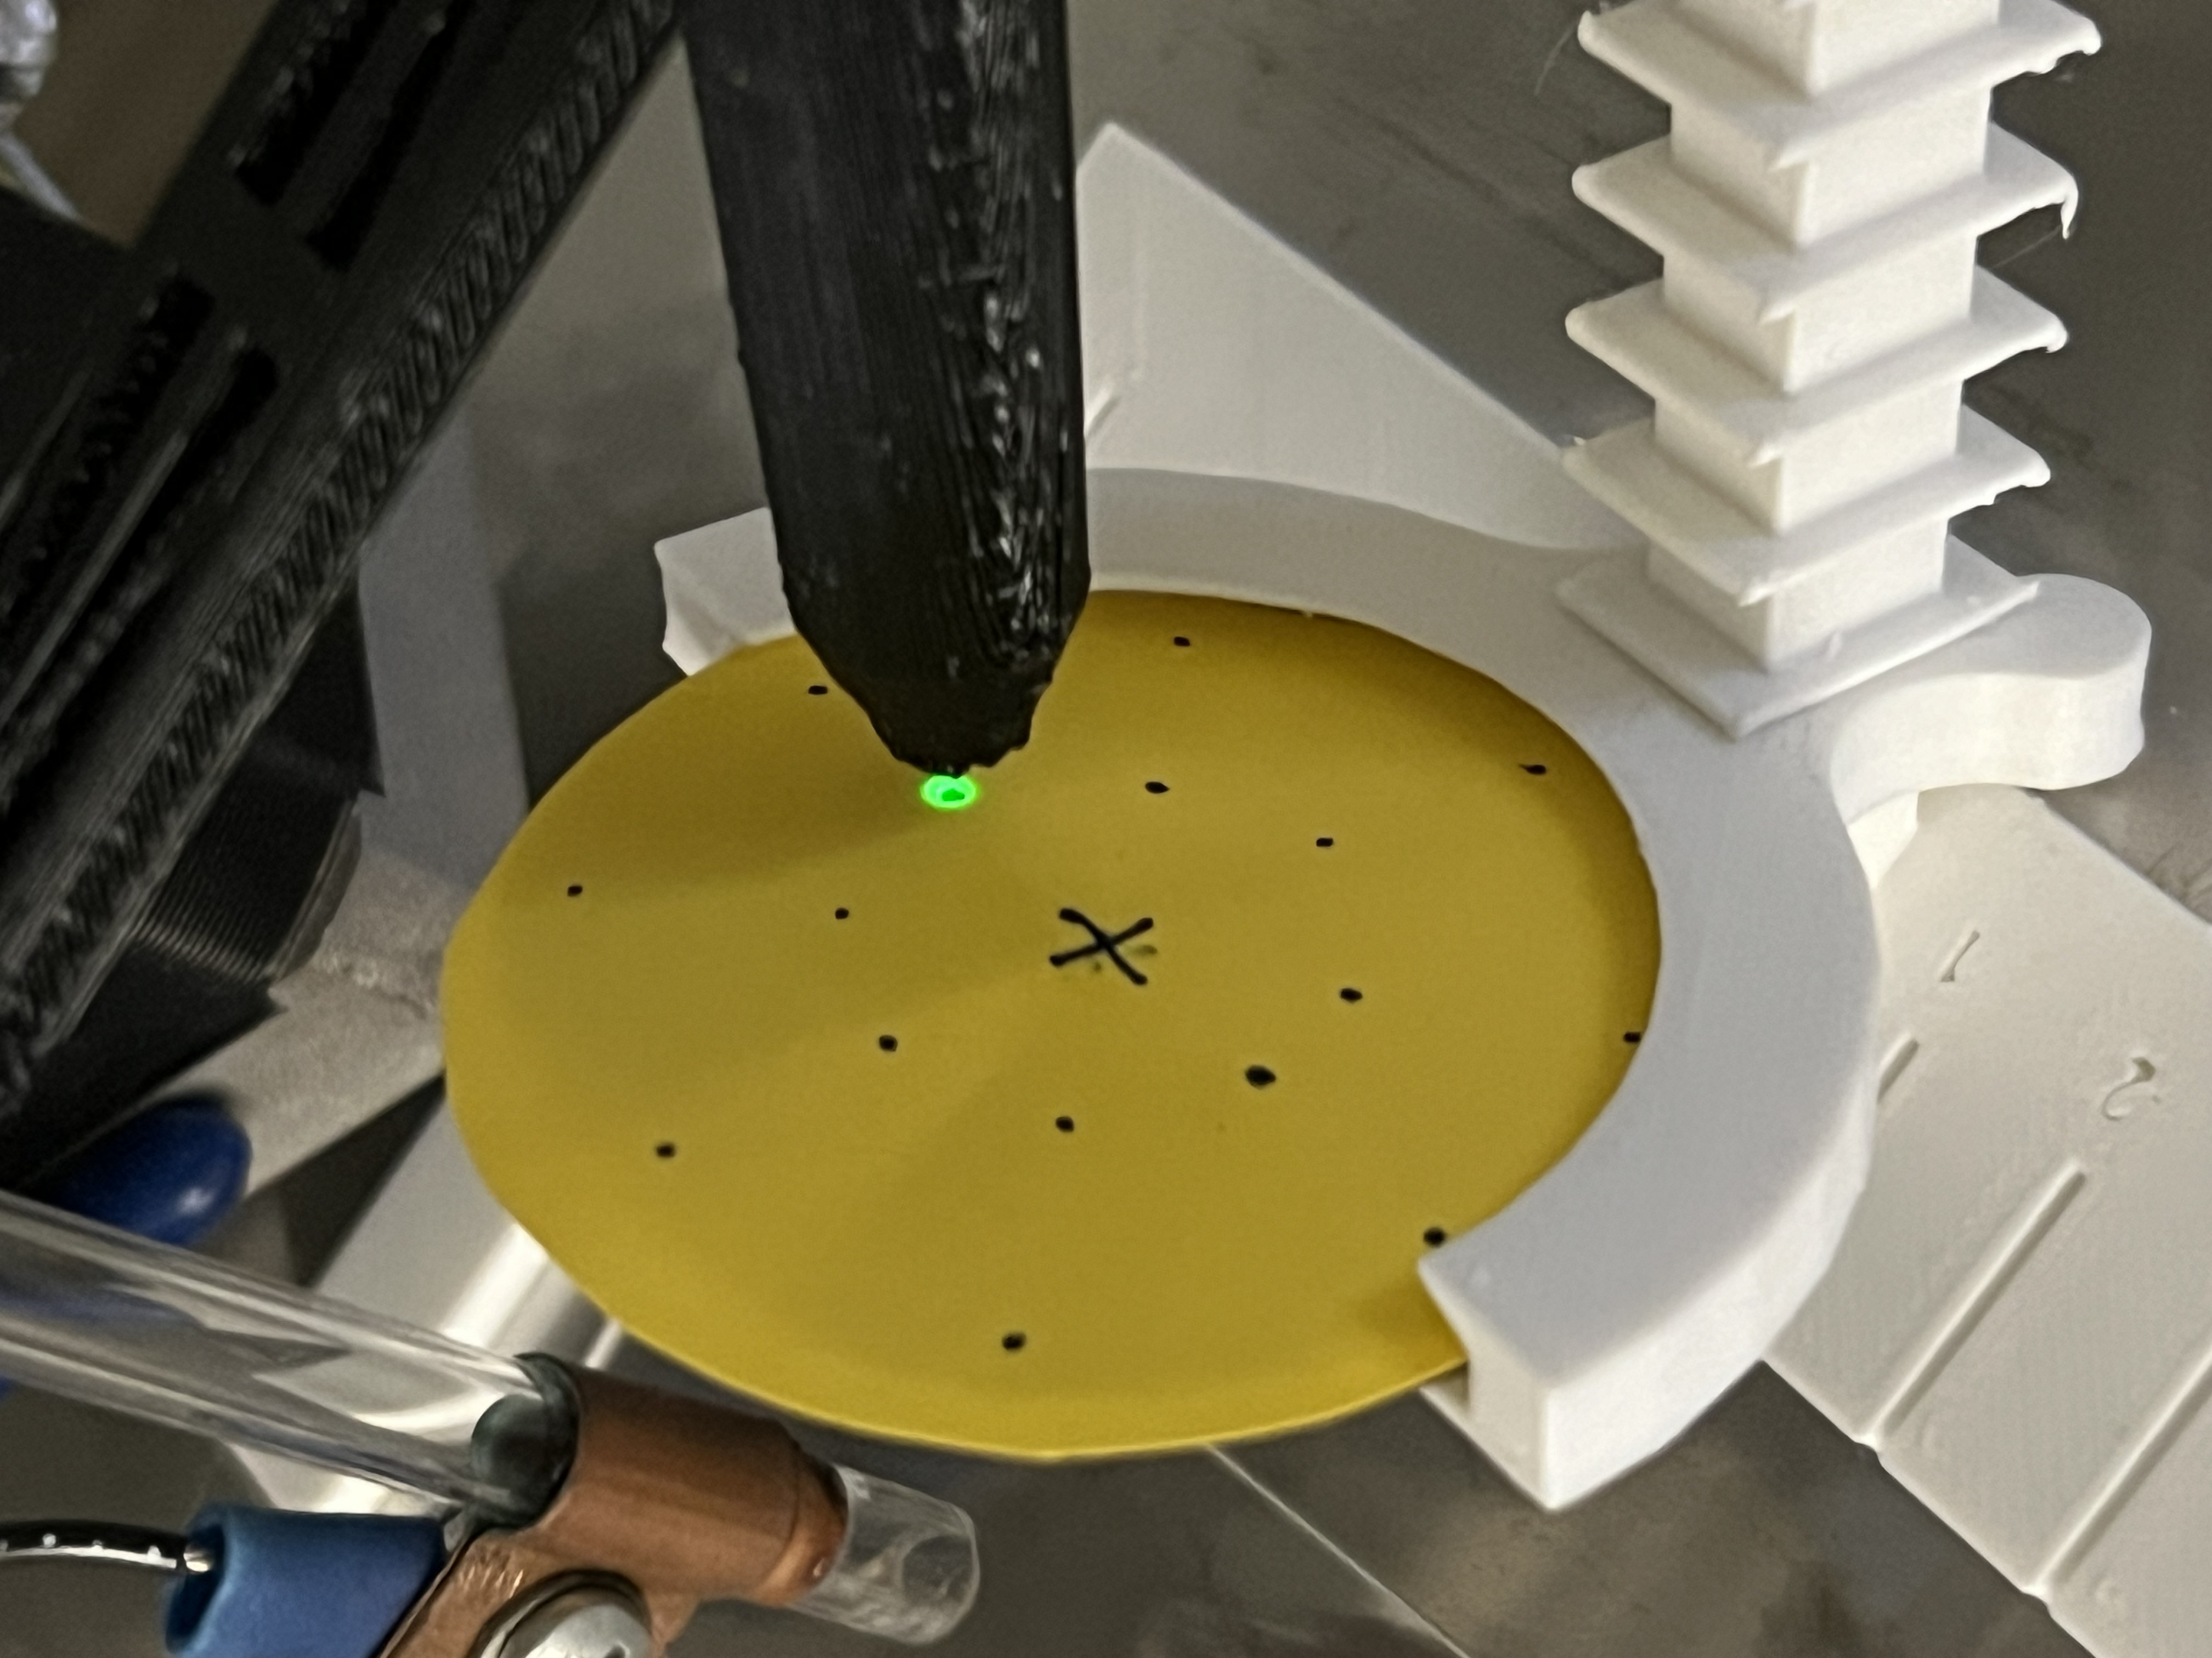
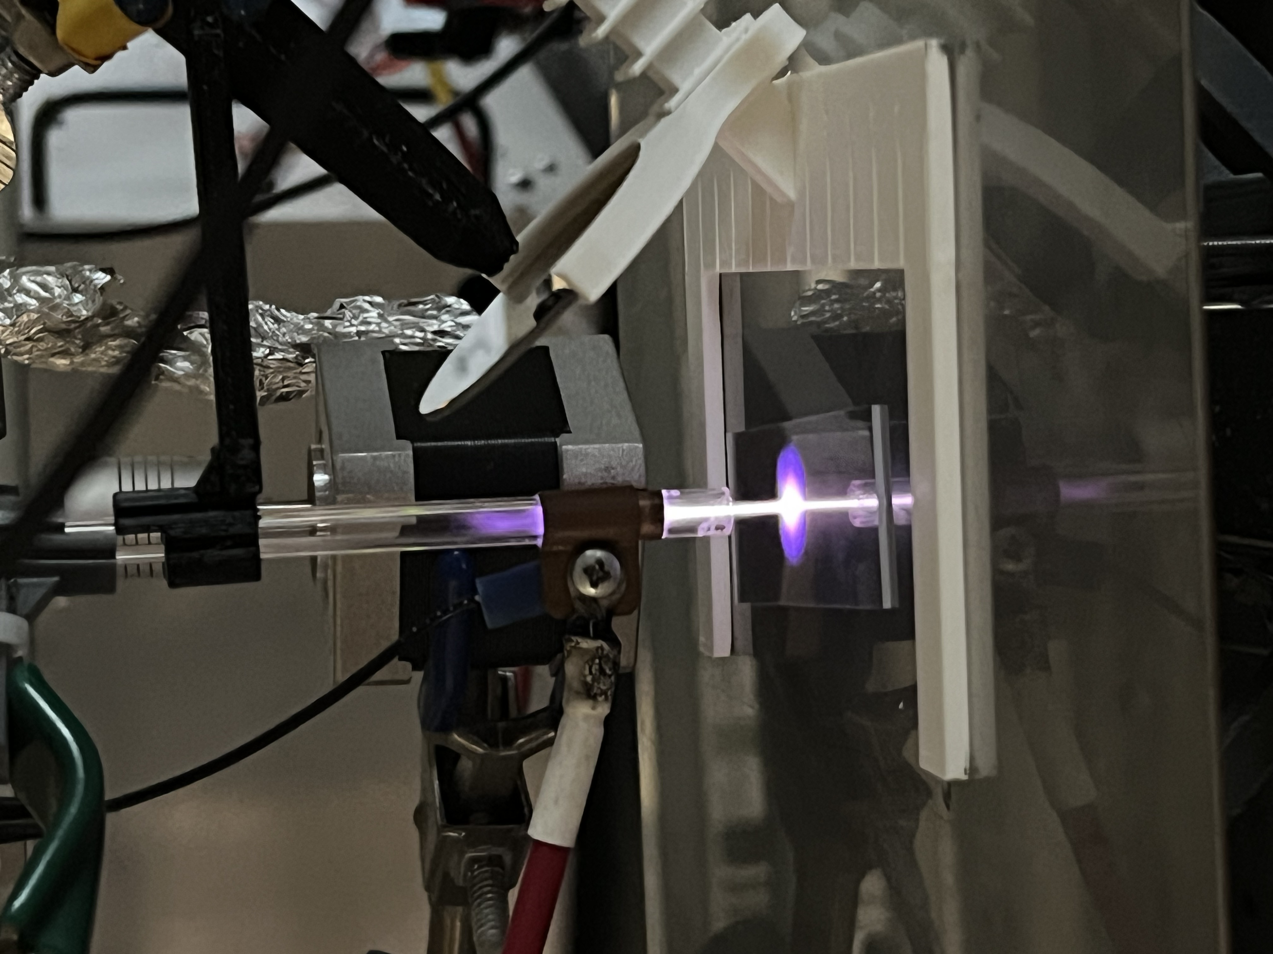
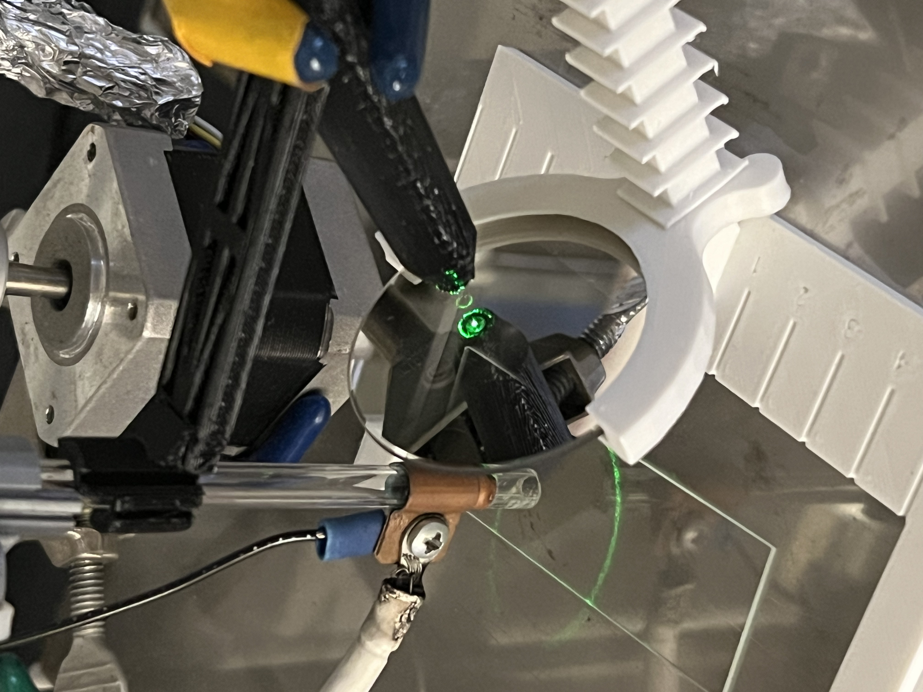
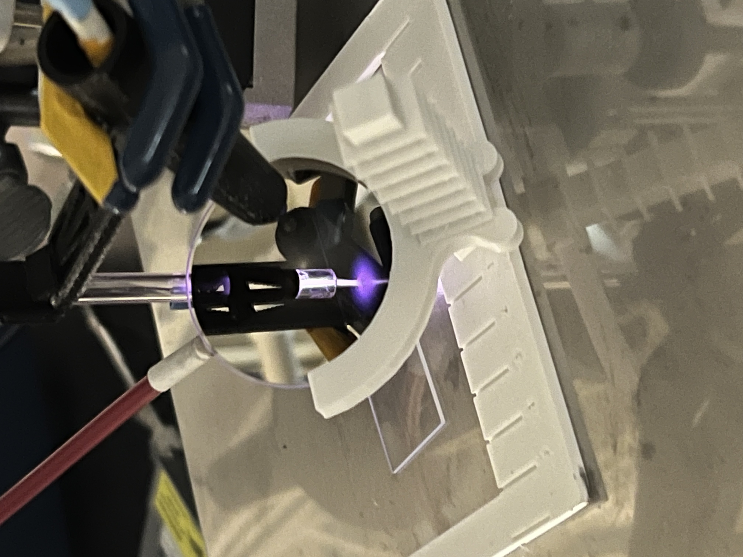
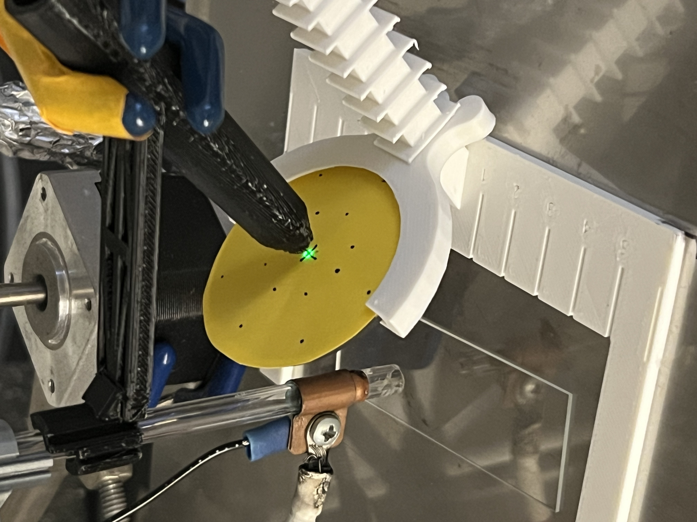
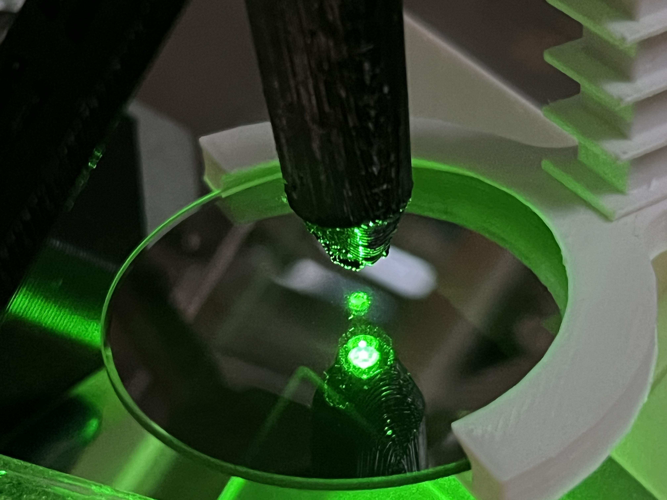
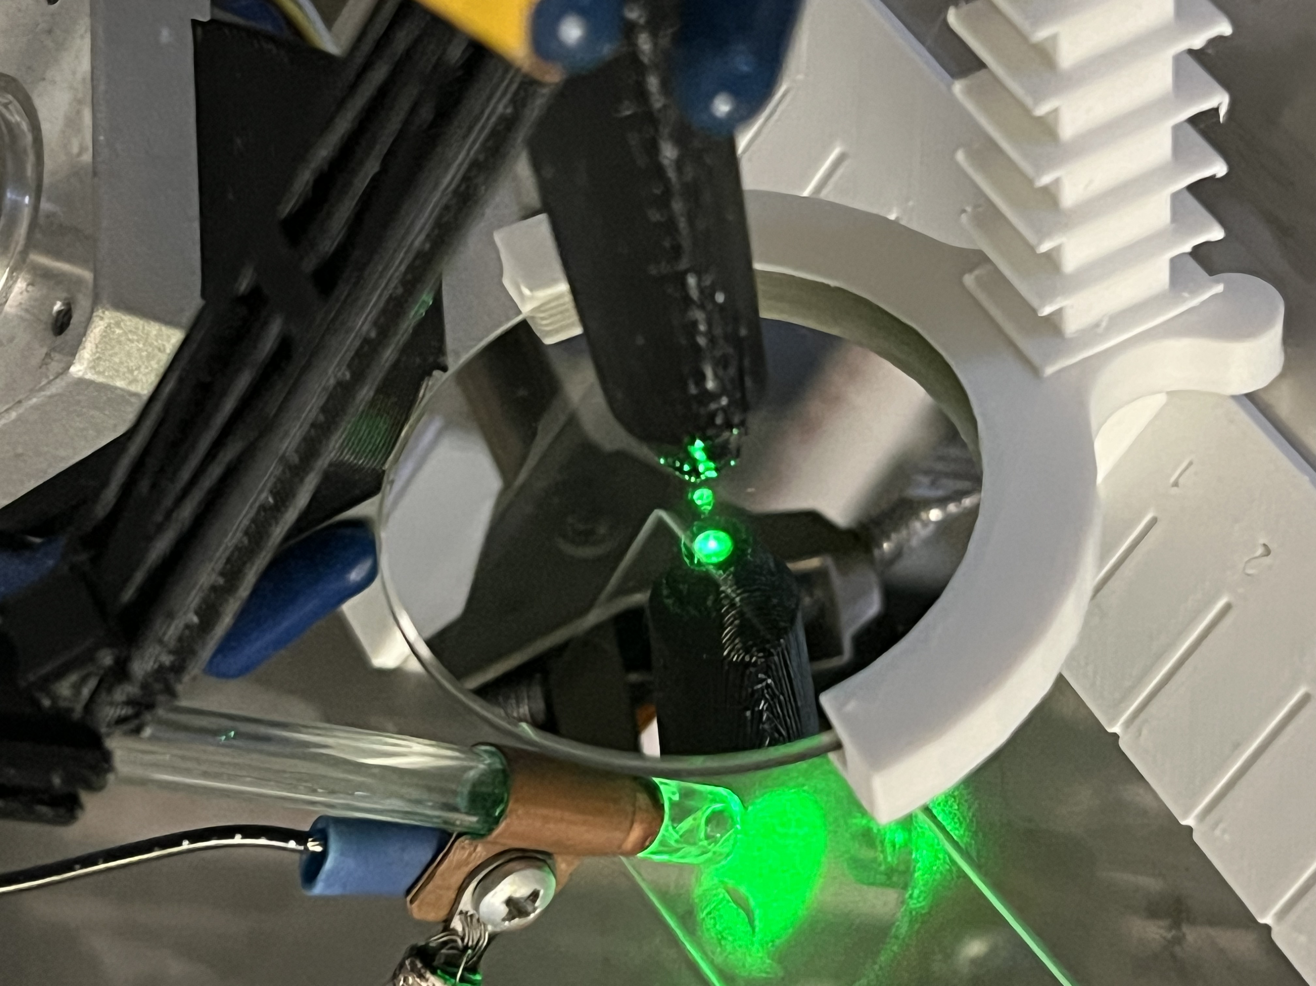
Experimental Setup

Slide 11
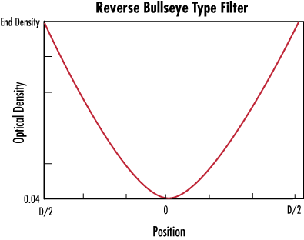
2.0
1.6
1.2
0.8
0.4
8.3
16.6
25

Slide 12
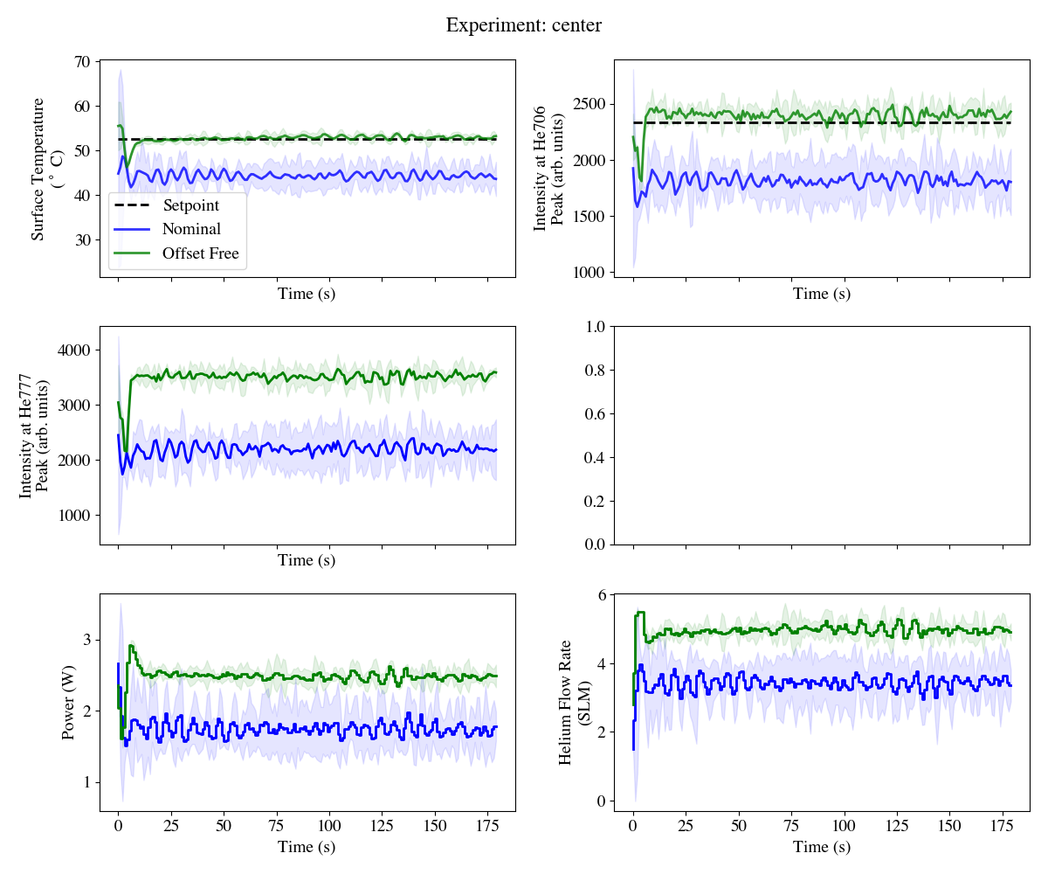
Closed-loop Experiment: ~Center of Filter (OD: ~0.04 – ~0.1)

Slide 13
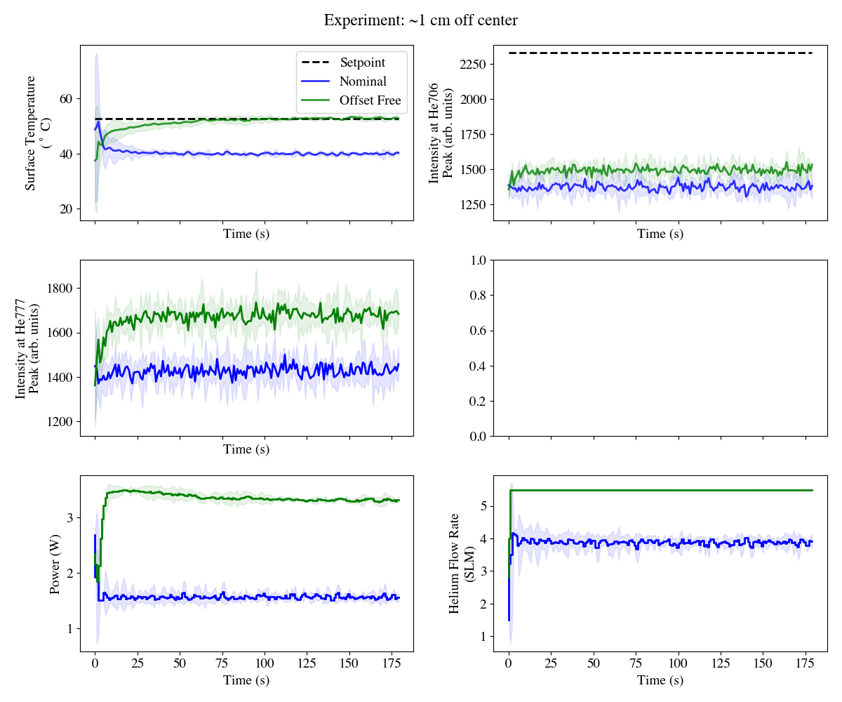
Closed-loop Experiment: ~1cm off-center (~OD: ~0.6)

